Slide 1

Cinematic Cameras
Cutscenes Made Easy

Slide 2
What and Why
Actors that change the player’s point of view
In-game cutscenes, intro sequences, maybe even Resident Evil-style static cameras?

Slide 3
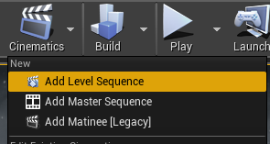
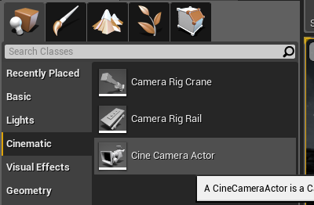
Implementing Cinematic Cameras
Thankfully, extremely simple
Add a level sequence to create a track for the cutscene to play out
Add at least one cine camera to make the camera view
Add keyframes to the timeline to transition between

Slide 4
Camera and Timeline Options
Can change camera type, focus, zoom, and a bunch of photography nerd stuff
Can set camera to track and autofocus on a certain actor
Can change actors’ positions, lights’ intensity, and other such properties with keyframes
Can play audio and cut between different cameras

Slide 5
Links
https://docs.unrealengine.com/en-US/Engine/Sequencer/HowTo/CineCameraActors/index.html
https://docs.unrealengine.com/en-US/Engine/Sequencer/HowTo/TriggeringSequences/index.html
https://www.youtube.com/watch?v=yEADOOJ9h6I
https://www.youtube.com/watch?v=k0tob5WBob0

