Slide 1
Minimaps

Slide 2
So, what’s a minimap?
Examples:

Slide 3
The 2 types of minimaps in Unreal:
Minimap using a camera render
  Beginner friendly
  Fast to implement
  Not very customizable
Minimap using a custom texture
  Advanced, even convoluted
  Highly customizable

Slide 4
The 2 types of minimaps in Unreal:
Minimap using a camera render
  Beginner friendly
  Fast to implement
  Not very customizable
Minimap using a custom texture
  Advanced, even convoluted
  Highly customizable

Slide 5
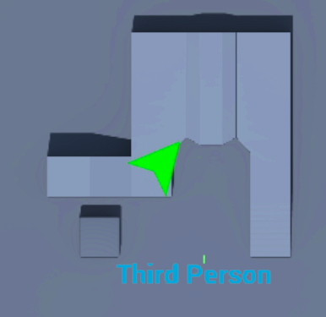
A quick overview!
We will be placing a “SceneCaptureComponent” in the character blueprint
We will be feeding this capture to a “RenderTarget”
We will be making this target into a dynamic material
We will be projecting this material onto a widget

Slide 6
Where to go from here?
Creating stylized textures and icons
NPC and object representation
Linking dynamic material to specific maps
Creating a wide array of sizes

Slide 7
Thank you!

Slide 8
Saucy Sources (90% of this is from the first and third)
[1] R. Laley, “Unreal Engine 4 Tutorial - Minimap (Basic),” YouTube, 15-Jan-2018. [Online]. Available: https://www.youtube.com/watch?v=EQgmt20knLo.
[2] “Using Spring Arm Components,” Unreal Engine Documentation. [Online]. Available: https://docs.unrealengine.com/en-US/Gameplay/HowTo/UsingCameras/SpringArmComponents/index.html.
[3] R. Laley, “Unreal Engine 4 Tutorial - Minimap (Advanced) - Part 1,” YouTube, 26-Jan-2018. [Online]. Available: https://www.youtube.com/watch?v=Z6qzaT4ZOh0.
[4] “USceneCaptureComponent2D,” Unreal Engine Documentation. [Online]. Available: https://docs.unrealengine.com/en-US/API/Runtime/Engine/Components/USceneCaptureComponent2D/index.html.
[5] “Paper 2D Sprites,” Unreal Engine Documentation. [Online]. Available: https://docs.unrealengine.com/en-US/Engine/Paper2D/Sprites/index.html.
[6] B. Humphreys, “Using Materials in Unreal UIs,” Ben Humphreys, 07-Jun-2017. [Online]. Available: http://benhumphreys.ca/unreal/ui-dynamic-materials/.

