Slide 1
Virtual Reality in Unreal
By: Laura Hill

Slide 2
Core Pillars of Good VR
Presence
Immersion
Comfort
Performance

Slide 3
Viewer Positions
Sitting
Standing
Room Scale

Slide 4
Movement & Interaction
Gamepads
Mouse & Keyboard
Gaze Control (ex: Google Cardboard)
Motion Controllers

Slide 5
Best Practices - Comfort
Consistently high framerate
User/Avatar Height
Viewer controlled camera at all times
Avoid fast acceleration & movement
Avoid camera lens effects

Slide 6
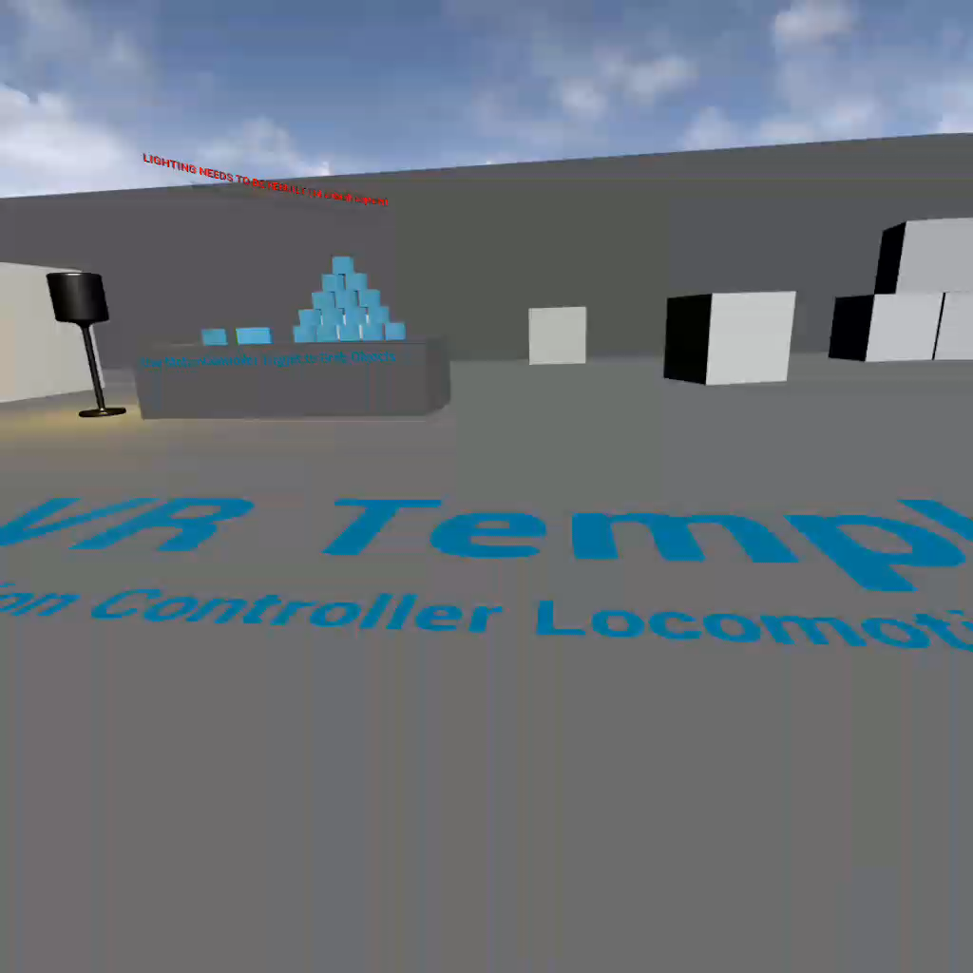
Grabbing Objects

Slide 7
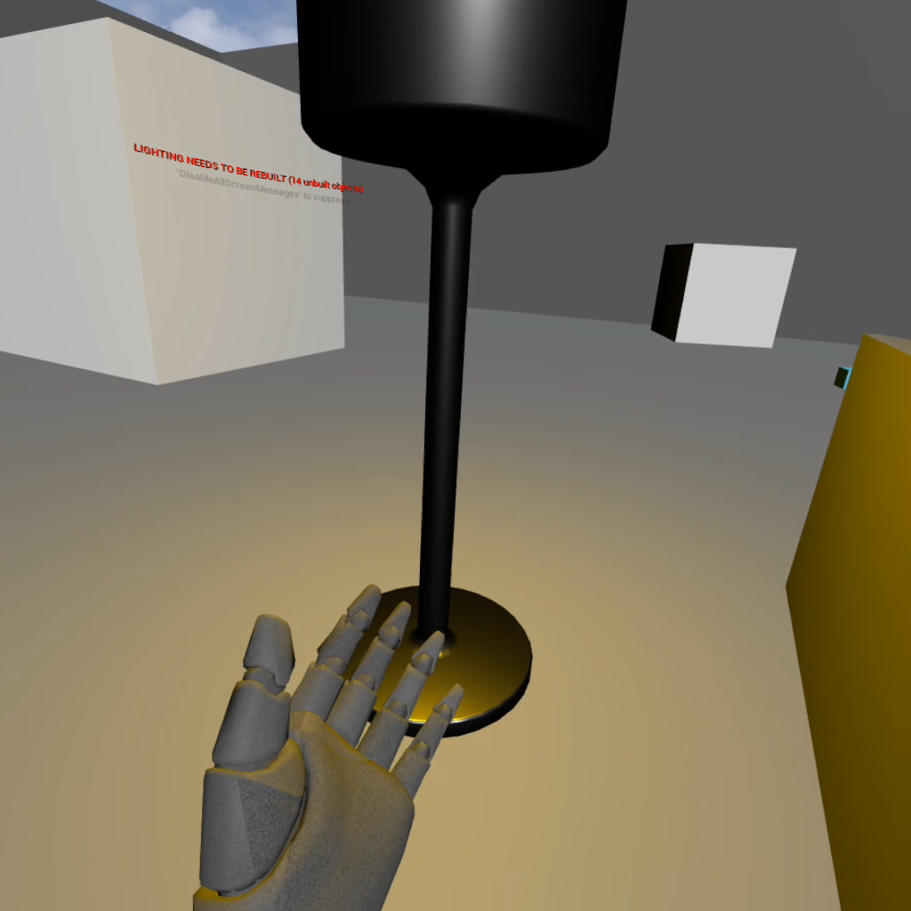
Turning a Light on & off

Slide 8
References
Oculus Quest and Go: Quick Start Guide:
  https://developer.oculus.com/documentation/unreal/unreal-quick-start-guide-quest/
Android Development Software Setup:
  https://developer.oculus.com/documentation/native/android/mobile-studio-setup-android/
Creating Virtual Reality Walkthroughs:
  https://learn.unrealengine.com/course/2436636?r=False&ts=637221437652479697

