Slide 1
Melee Attacks
Mason Biggie

Slide 2
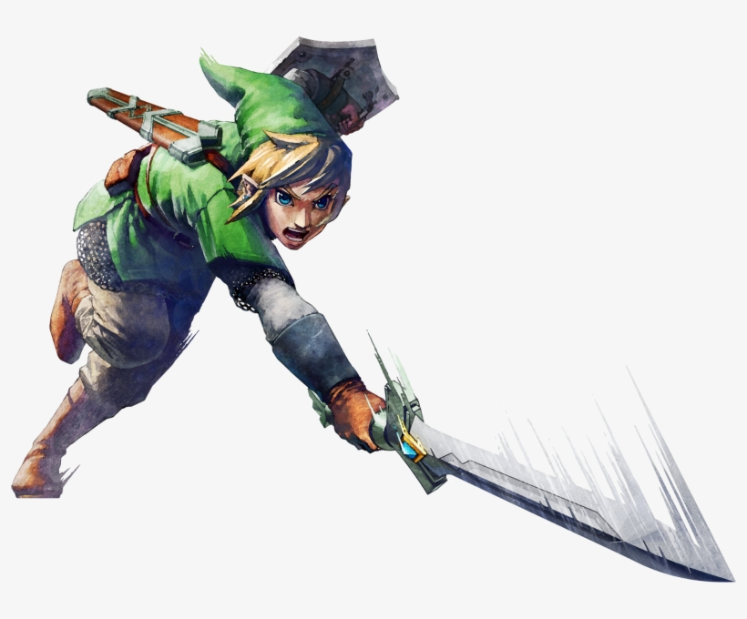
Introduction to Melee Attacks
We have worked with projectiles and line trace related damage so far
My goal was to investigate on how to create attacks from close range (sword swings, punches, etc.)
I must explain some of the moving parts so we can get a full grasp on melee attacks

Slide 3
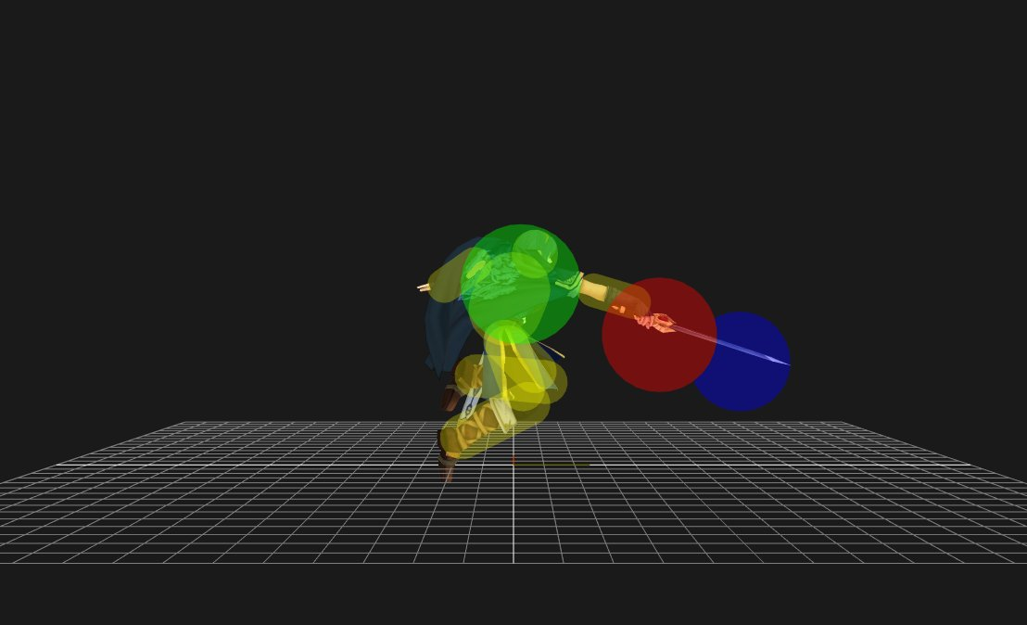
The Main Blueprint
The biggest part of creating a melee attack is the collision box primarily referred to as a “hitbox”
This is the piece that will need to wrap around the actor that is performing the attack
When it hits another actor’s “hurtbox” or their collision box for their body, damage will be applied to the other actor
These are hurtboxes
These are hitboxes

Slide 4
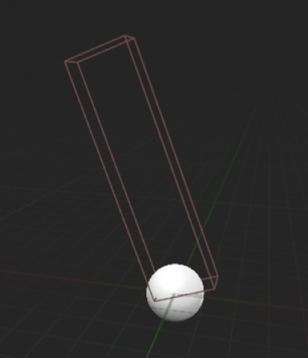
Hitbox Blueprint
This blueprint was simpler than I originally imagined
There are many ways to deal with hit detection in Unreal, but I found this to be best for 3D spaces
I created a blueprint “SwordHitBox” that was shaped out to how I needed it
While there are ways to make damage events within this blueprint, I decided to implement detection for the hitbox from within the target enemy itself.

Slide 5
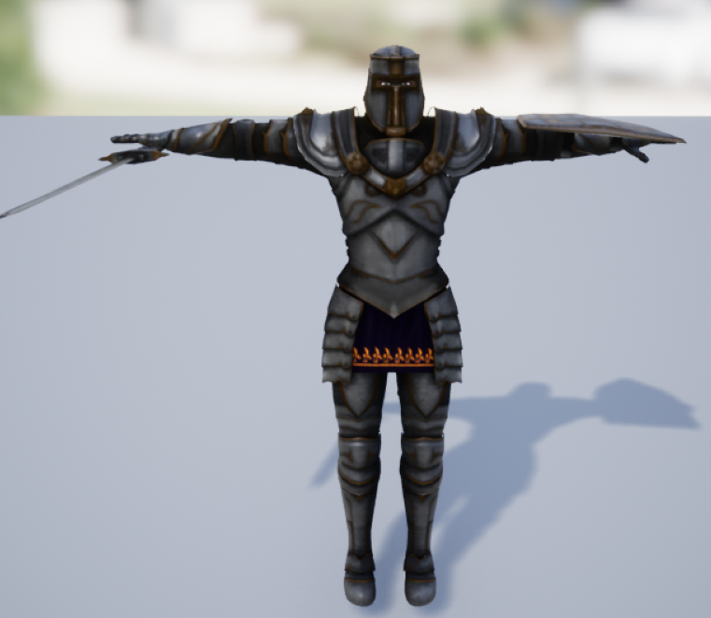
Model for the Attack
To have an example for the melee attack, I wanted to have a model with animations
I grabbed this knight and some sword swing animations from Mixamo

Slide 6
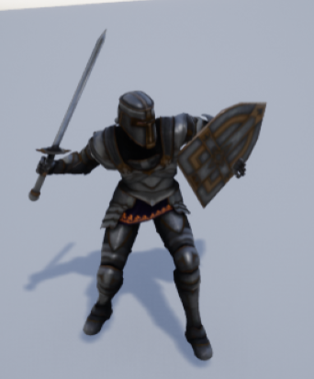
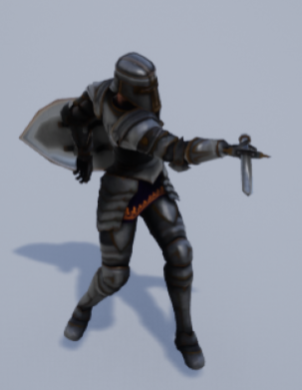
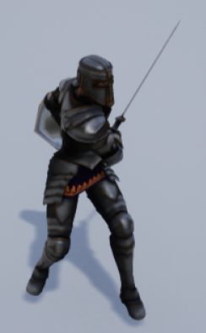
Attack Animations Startup Active Recovery
The frames of animation before an attack(easing in)
The attack itself. This is where the hitbox appears
The frames after the attack has happened(follow through)

Slide 7
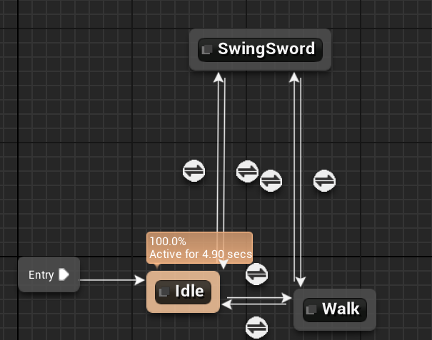
States of Animation
To keep the attack animation working and able to transition between states, I made a simple state tree(to the right)
This says that the character can swing the sword while idle and while walking. Else you could only attack while idle.
The blueprint in my CharacterAnimBP transitions between idle and walking based on the ThirdPersonCharacter’s speed value(velocity) and the SwingSword animation is played when a Boolean flag is set to true.

Slide 8
Now for the fun part…
Looking at the ThirdPersonCharacter blueprint, in the event of InputAction LightAttack, it checks if LightSwordSwing is false. If so, set it to true. Here so you can’t just spam the attack mid-animation.
I also disable movement to that the character can’t slide around while performing the attack
A delay is set to handle the startup frames of the swing.
For the active frames, the SpawnActor node is used to spawn the SwordHitBox at the Sword_joint socket of the knight’s skeletal mesh. I then use AttachToComponent to make sure the hitbox stays on the sword.

Slide 9
Finishing the Attack
A second delay to make for the active frames. Afterwards, the SwordHitBox is destroyed.
A final delay to work as recovery frames
Setting LightSwordSwing back to false so the attack can be used again as well as returning movement to the player.

Slide 10
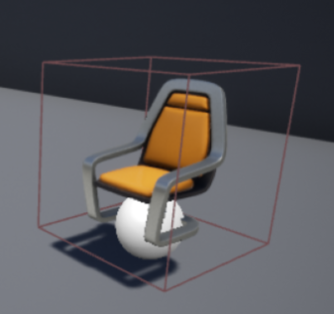
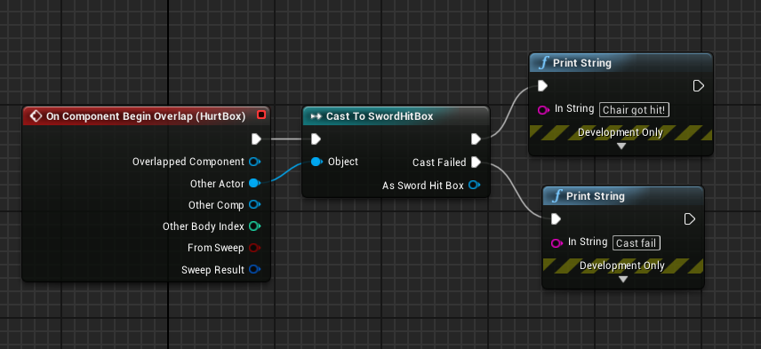
The Ultimate Foe, The Suspended Chair
Now we can look at the enemy blueprint and see how it detects the hitbox.
To make things simple, I did an event on begin overlap with the chair’s hurtbox. It casts the actor that overlaps with it to the sword hitbox.
If cast is successful, print “Chair got hit!” Else, print “Cast fail”
Consider the hitbox and hurtbox collision options in the Details panel

Slide 11
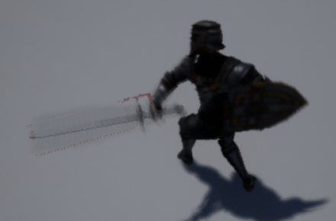
Conclusion
Combining the animations, hitboxes, and hurtboxes, a working melee attack is created.
To make other attacks, different hitboxes can be created to distinguish the type of attack the player is using, i.e. Light Attacks and Heavy Attacks
With these steps, you could very well create a full melee move set/attacking states set for a character in Unreal.

Slide 12
References
[1] Virtus Learning Hub / Creative Tutorials. “Melee Combat Based Character - #19 Creating A Role Playing Game With Unreal Engine 4,” YouTube, Aug. 20, 2017 [Video file]. Available: https://www.youtube.com/watch?v=wgDABICTslM&list=PLL0cLF8gjBp qA8DcrhL_O9kD4jsUqhDR6&index=19. [Accessed: Mar. 24, 2020].
[2] Virtus Learning Hub / Creative Tutorials. “Melee Weapon Damage - #23 Creating A Role Playing Game With Unreal Engine 4,” YouTube, Aug. 29, 2017 [Video file]. Available:
https://www.youtube.com/watch?v=LjDsPr4ujDE&list=PLL0cLF8gjBpq A8DcrhL_O9kD4jsUqhDR6&index=23. [Accessed: Mar. 24, 2020].
[3] Mixamo. “Paladin_Prop_J_Nordstrom” Accessed on: Mar. 23, 2020. [Online]. Available: https://www.mixamo.com/#/?page=1&type=Character

