Slide 1
Vehicles in Unreal Engine
Anthony BEllucci

Slide 2
Tips for Art Assets

Slide 3
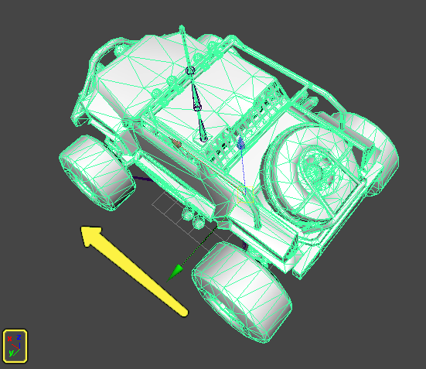
AXis
The X axis is the forward direction

Slide 4
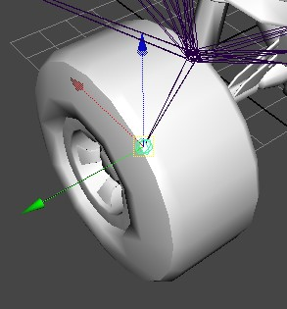
Joints
Make sure to keep these centered on the wheels, or else it is going to look unrealistic

Slide 5
Physics Asset
Necessary for the vehicle
Car frame → Box
Wheels → Sphere

Slide 6
Tire Config and Wheel Blueprints

Slide 7
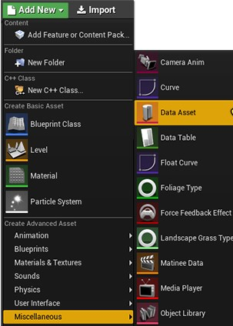
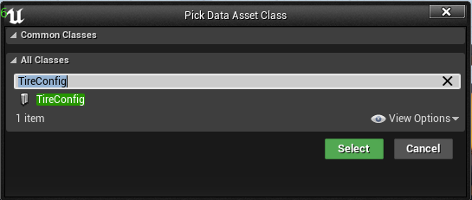
Tire Config
Choose the Data Asset Class
Selecting Data Asset
Controls the friction scale
Data Asset → TireConfig
Show TireConfig properties

Slide 8
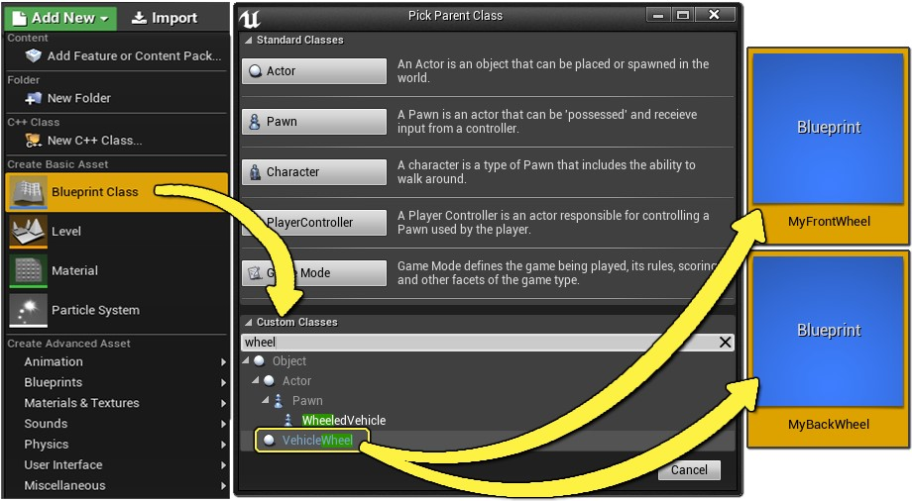
Wheel Blueprint
Creating Wheel Blueprints
Going to need two – one for front wheel, one for back wheel

Slide 9
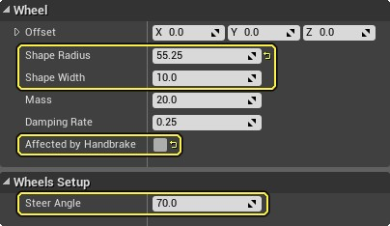
Wheel Blueprint
Editing the Tire Config
Properties to change:
Shape Radius
Shape Width
Affected by handbrake
Steer Angle
Tire Config
Editing the first 4 properties

Slide 10
Animations

Slide 11
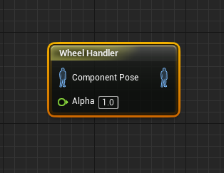
Wheel Handler Node
Makes the whole process far easier
Translates the information to animation

Slide 12
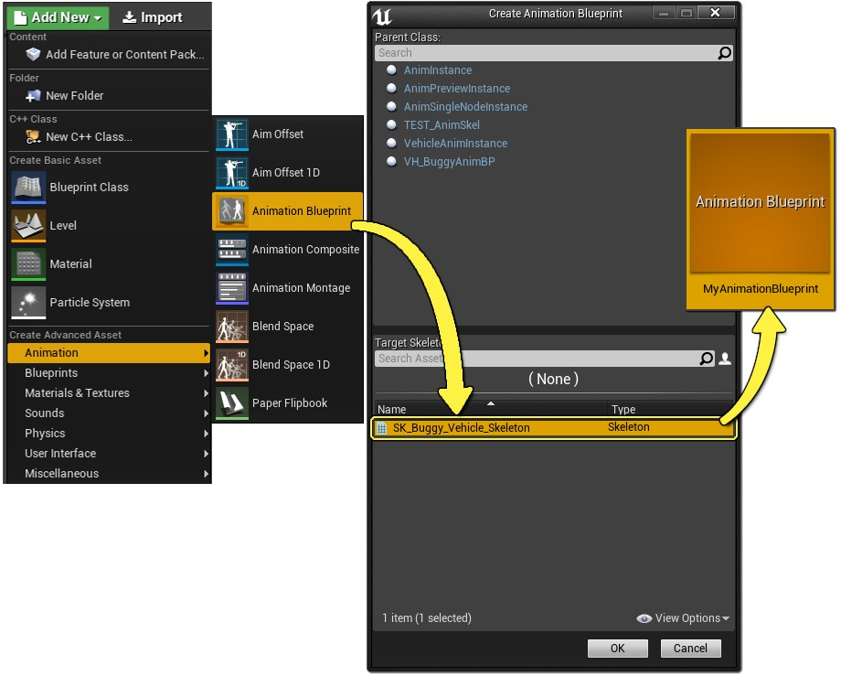
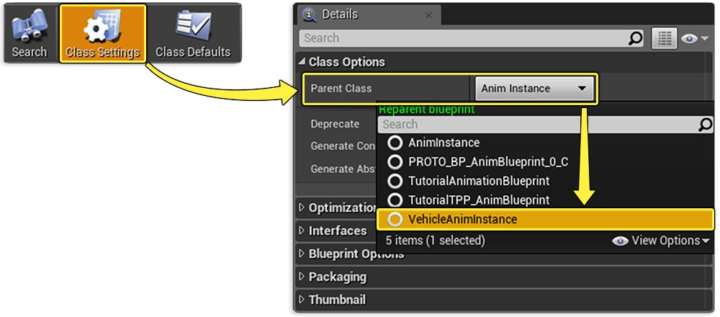
Animation Blueprint
Create an animation blueprint
Set the parent to VehicleAnimInstance
Selecting Animation Blueprint
Selecting VehicleAnimInstance

Slide 13
Anim Graph
The AnimGraph
Go to the Animation Graph
“Look At” all the wheels

Slide 14
Vehicle Blueprint

Slide 15
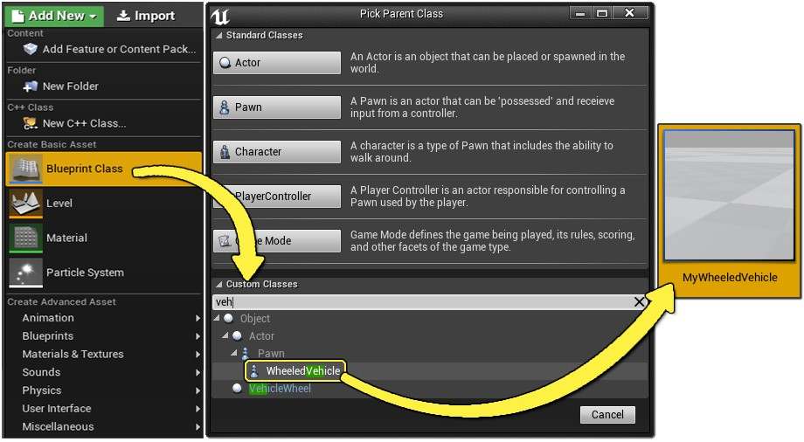
Vehicle blueprint
Selecting the WheeledVehicle class
This is the blueprint of the vehicle to bring it all together
Choose the WheeledVehicle blueprint

Slide 16
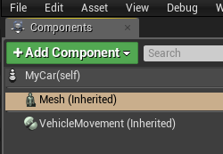
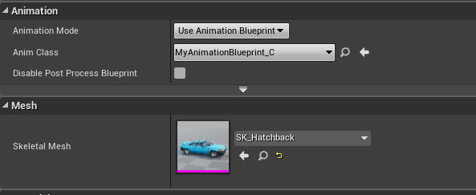
Vehicle Blueprint
Under the Mesh component, set:
Skeletal Mesh
Anim Blueprint Generated Class
Mesh
Setting the Properties of Mesh

Slide 17
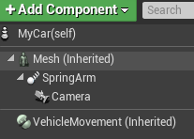
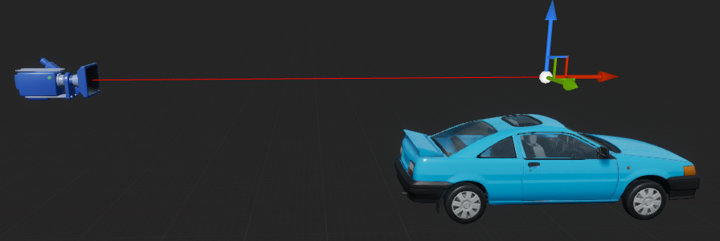
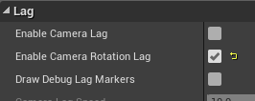
Setting up a camera
Spring Arm
Graphic of Spring Arm
Create a spring arm
Target Arm Length
Enable Camera Rotation Lag
Change height
Add the camera
Attach to the spring arm
Make sure Use Pawn Control Rotation is set to false
Target Arm Length
Enable Camera Rotation Lag
Use Pawn Control Rotation

Slide 18
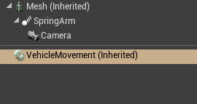
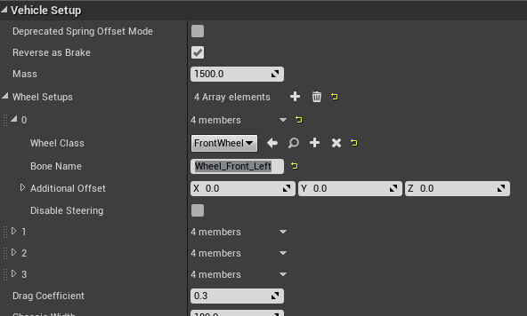
Vehicle Movement Component
Vehicle Movement Component
Vehicle Setup
Select the Vehicle Movement Component
Change the Wheel Class
Make sure this is the correct one – front or rear
Change the Bone Name
Must be exact
Can click the + icon to add more wheels if necessary

Slide 19
Using the Vehicle

Slide 20
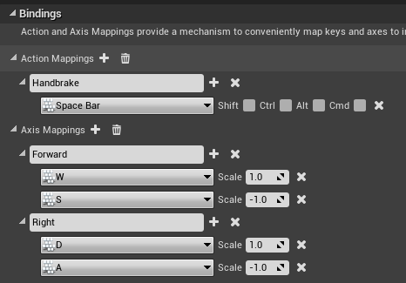
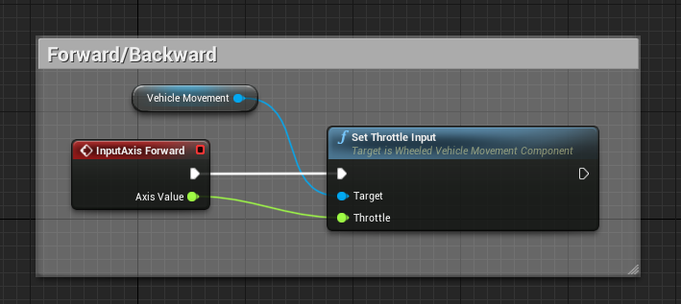
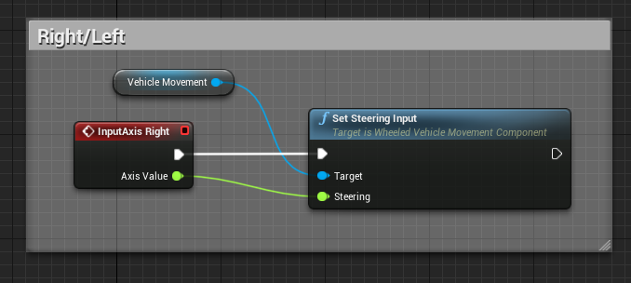
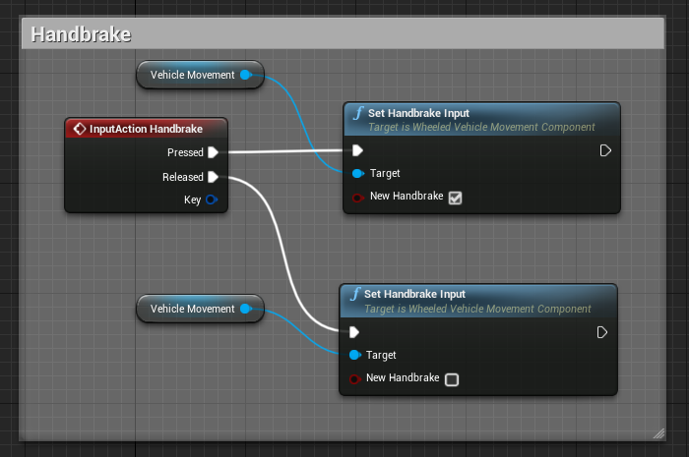
The controls
Forward/Backward
Key Bindings
Right/Left
Edit → Project Settings → Input
Axis Mappings
Handbrake

Slide 21
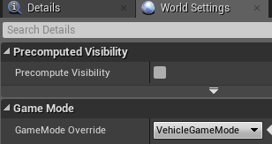
Game mode
Creating a new GameMode
Default Pawn Class
Make new blueprint
Default Pawn Class
GameMode Override
GameMode Override

Slide 22
Center Of MAss

Slide 23
Default Center of Mass
Adjusted Center of Mass

Slide 24
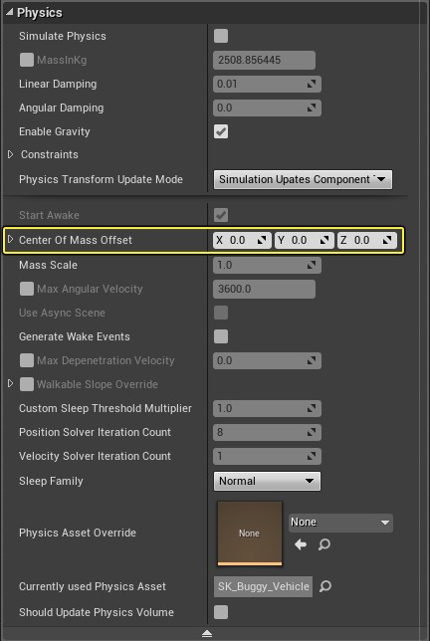
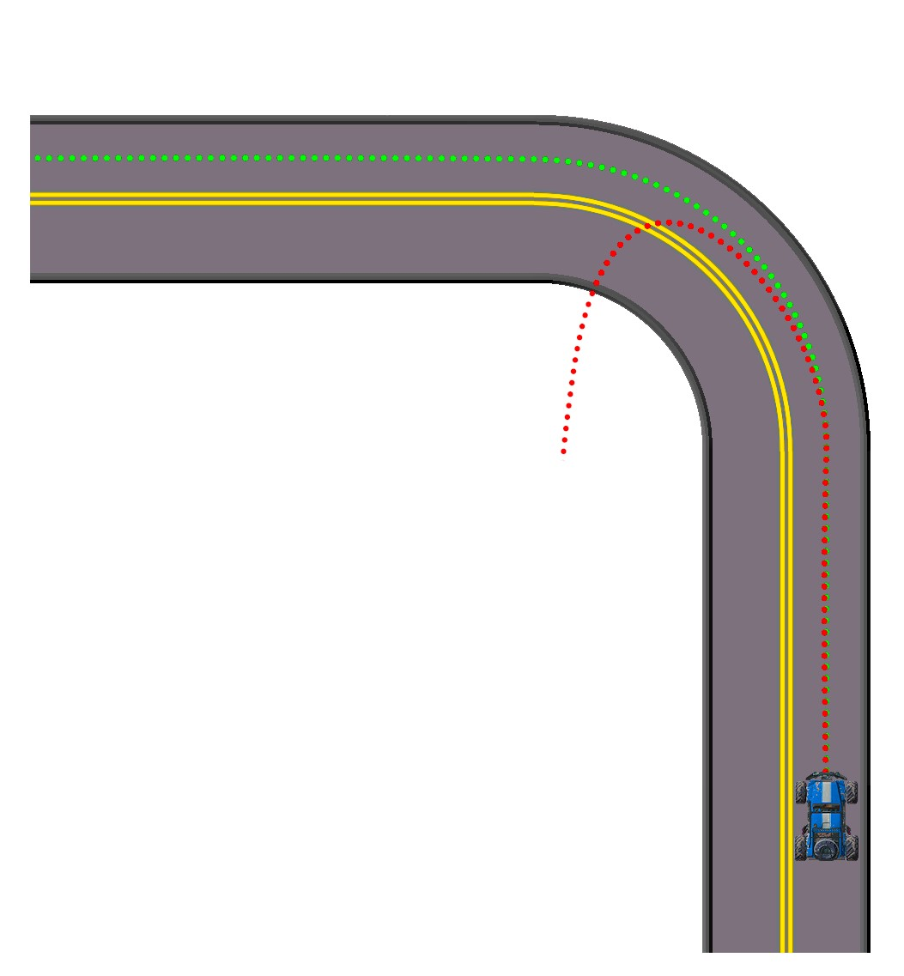
Center of Mass
Center of Mass Properties
Center of Mass offset
In the Physics Asset
Kinematic setting
Difference in center of mass can heavily change how your vehicle drives
Lower, further back on the car is generally better

Slide 25
Demonstration

Slide 26
References
Official Unreal Engine YouTube tutorial
YouTube tutorial by Michael Milord
Joints tutorial by Lusiogenic
Unreal Engine Vehicle Guide Documentation
Joints tutorial by UnrealTek

