Slide 1
Materials
By Corey Becker

Slide 2
Physically based rendering (PBR)
Values based on real world value allowing material creation to be more predictable
Materials are more accurate in different lighting conditions.
Doesn’t have to mean photorealistic PBR is used by Pixar and in Fortnight for stylized shading.
Has 4 main parameters in Unreal:
  Base Color
  Roughness
  Metallic
  Specular

Slide 3
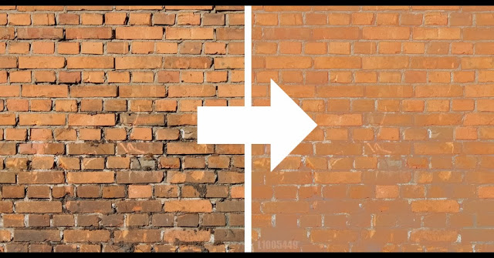
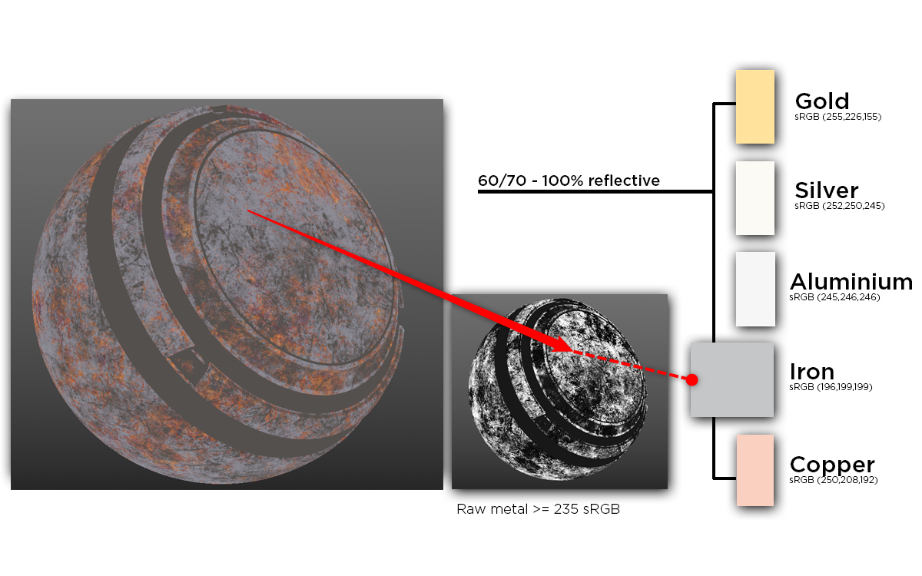
Base Color aka. Diffuse or Albedo
This is the color of the material without any lighting information.
Since it is a PBR system you can get real world values for the color of materials.
Real materials should never be 0 or 1 in value. Examples:
  Charcoal = 0.02
  Fresh Concrete = 0.51
  Fresh snow = 0.81

Slide 4
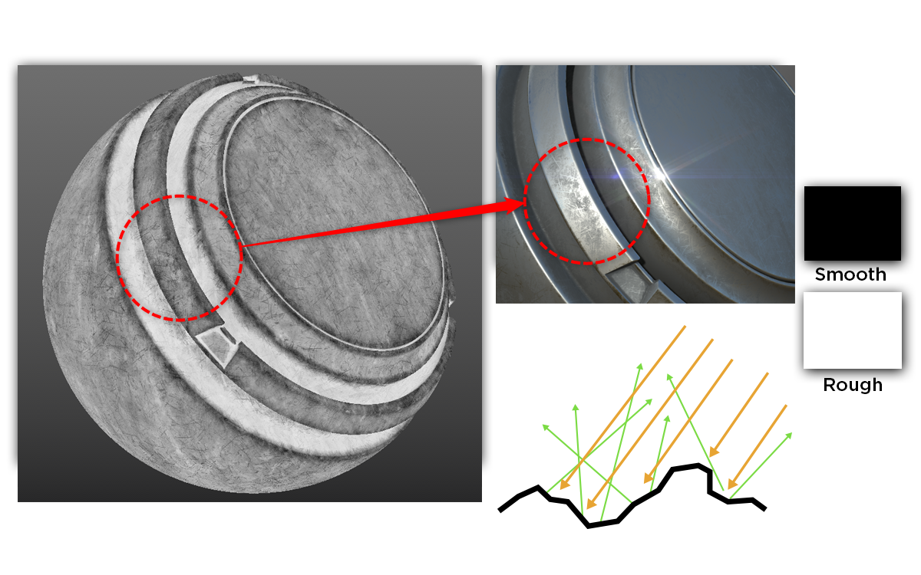


Roughness
Describes the micro surface detail and how light is reflected.
The more rough a surface it is the larger the specular highlight making a surface less shiny. The inverse is also true.
Again real world values are never 0 or 1

Slide 5

Metallic
Describes if something is a metal or non-metal (Dielectric)
Pure materials are either a metal (1) or Dielectric (0)
Middle values are mainly used for mixed materials like metal with dirt on it.

Slide 6
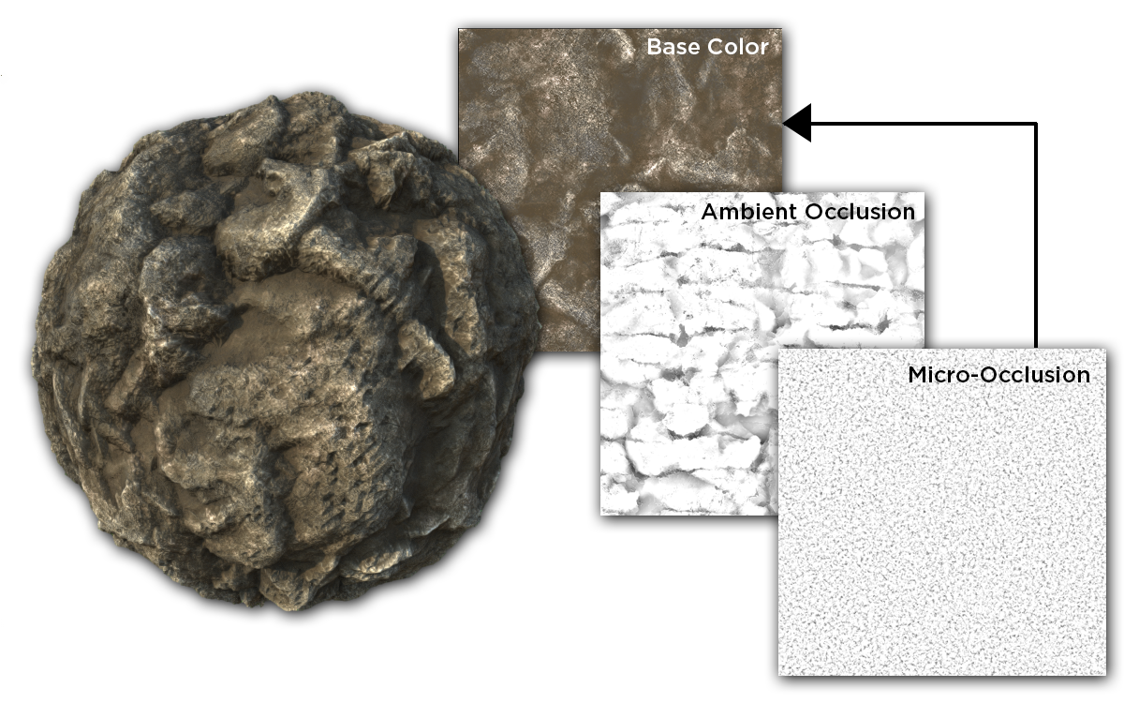
Specular
Controls the amount of light reflected. Default value is 0.5 which works for most materials.
Real world materials all have at least some specular. So again shouldn’t be set to 0 or 1 for realistic materials.
The default value is often best and if you want a material less shiny should adjust roughness instead.
Most common application is to create micro occlusion with a map.
*Micro-occlusion can be baked into base color or part of a specular map.

Slide 7
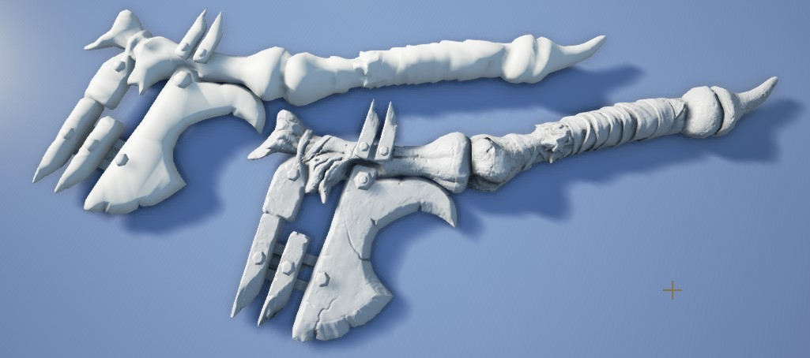
Normal
Adds detail to a material that is not in the mesh.
Is a trick with lighting and doesn’t change the actual geometry or silhouette.

Slide 8
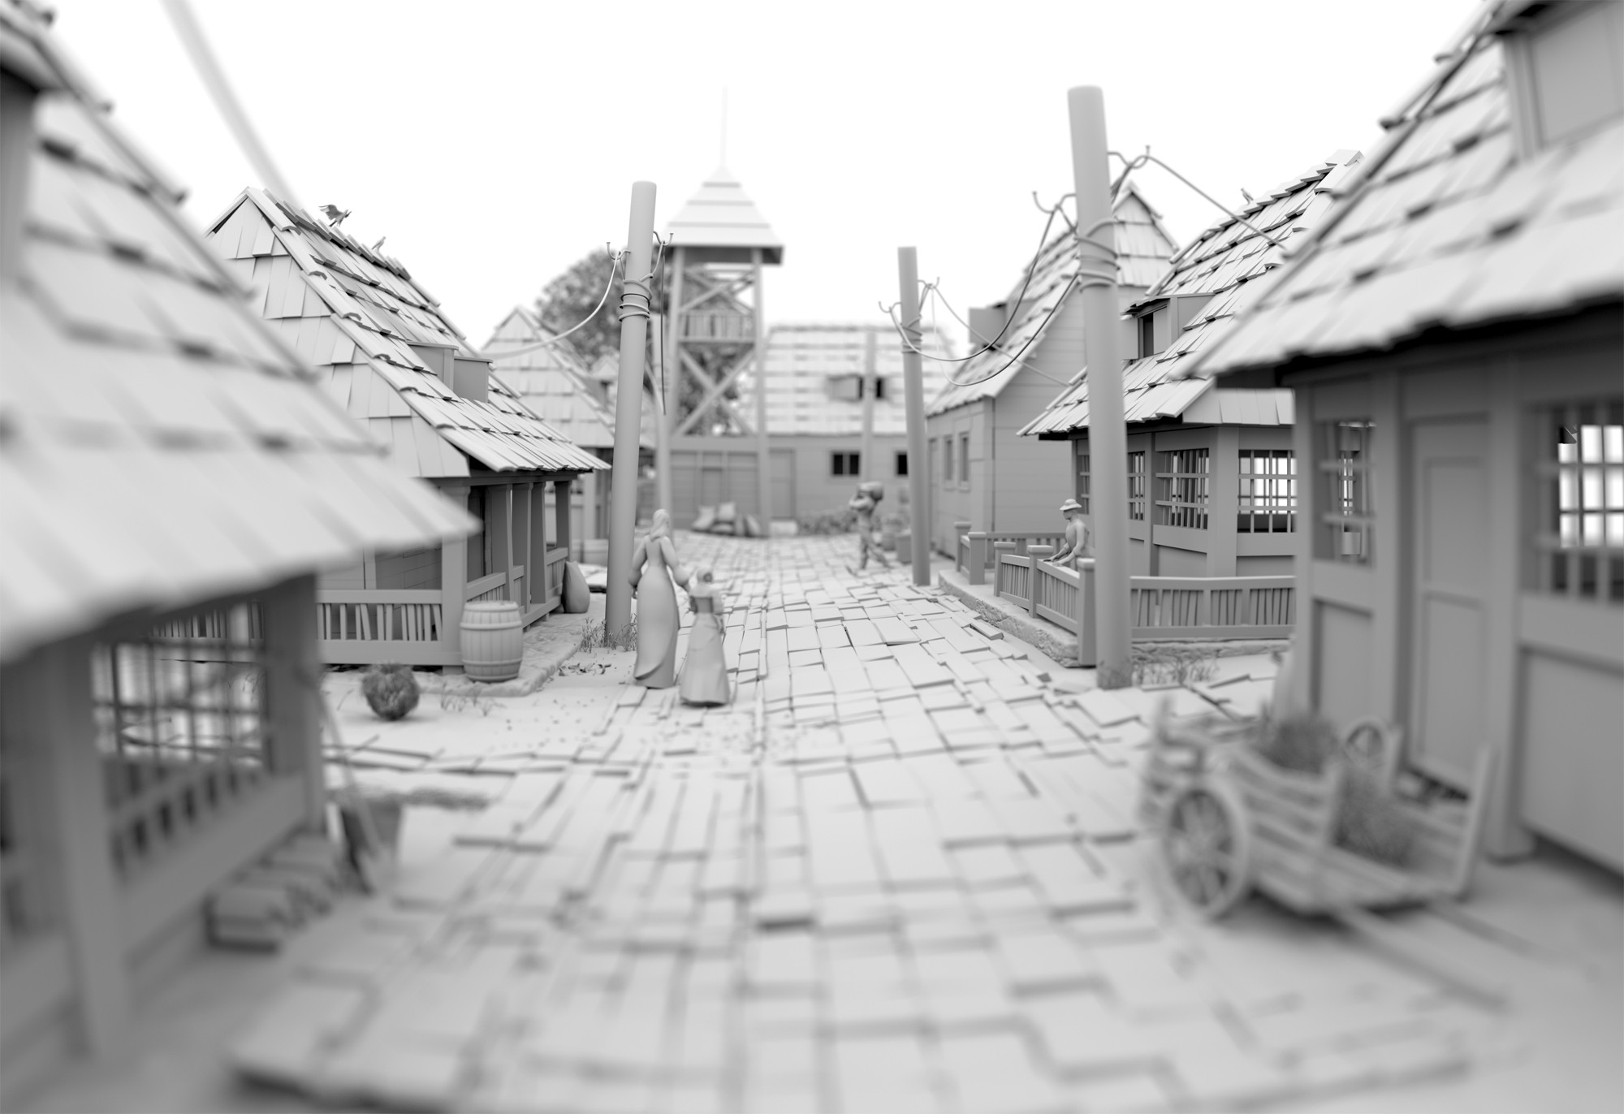
Ambient occlusion
Is the shadowing between close objects resulting form light bounces not reaching those areas.
Putting it in a map to the shader helps the rendering Ambient Occlusion later.

Slide 9
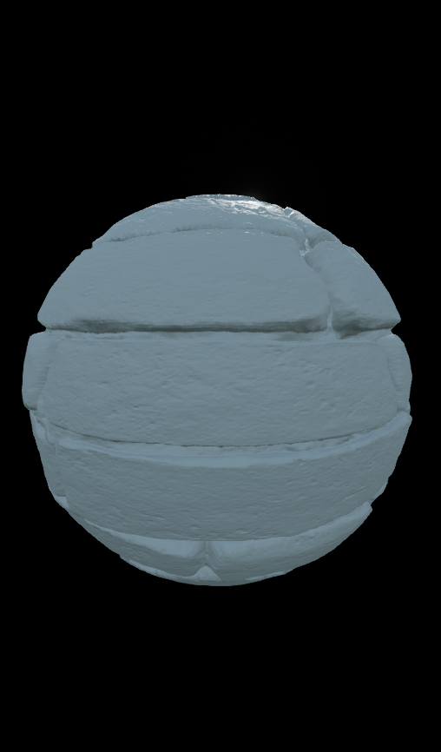
Displacement/Height
Unlike normal map actually moves the Vertices.
Unreal has two different inputs for Displacement
  World position offset which does not add geometry
  World Displacement which Tessellates the mesh adding more vertices to displace.

Slide 10
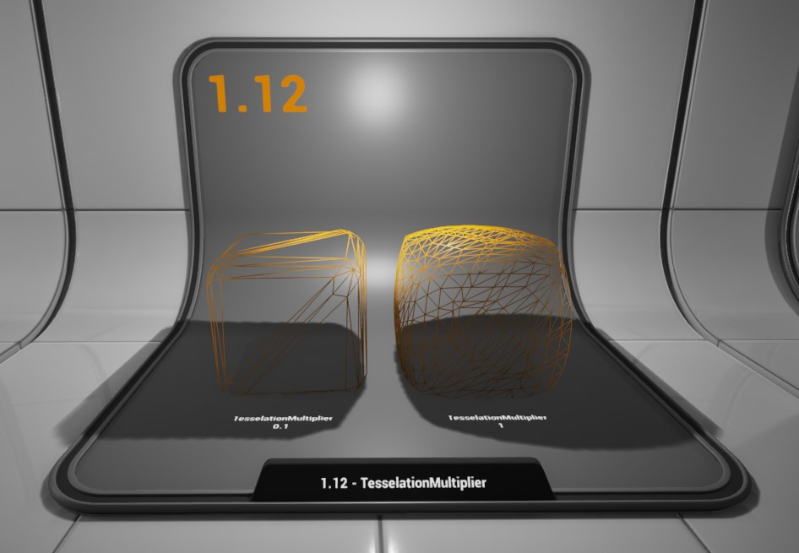
Tessellation Multiplier
Changes how much the mesh is tessellated I.E. how much extra geometry is added.
The larger number allows more detail but also is more taxing on the system.

Slide 11
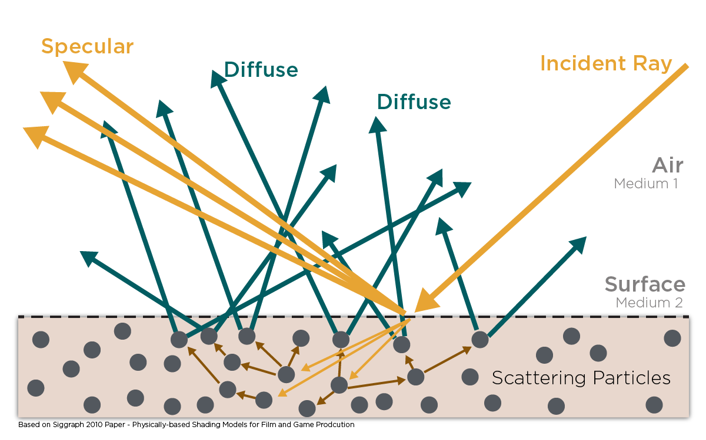
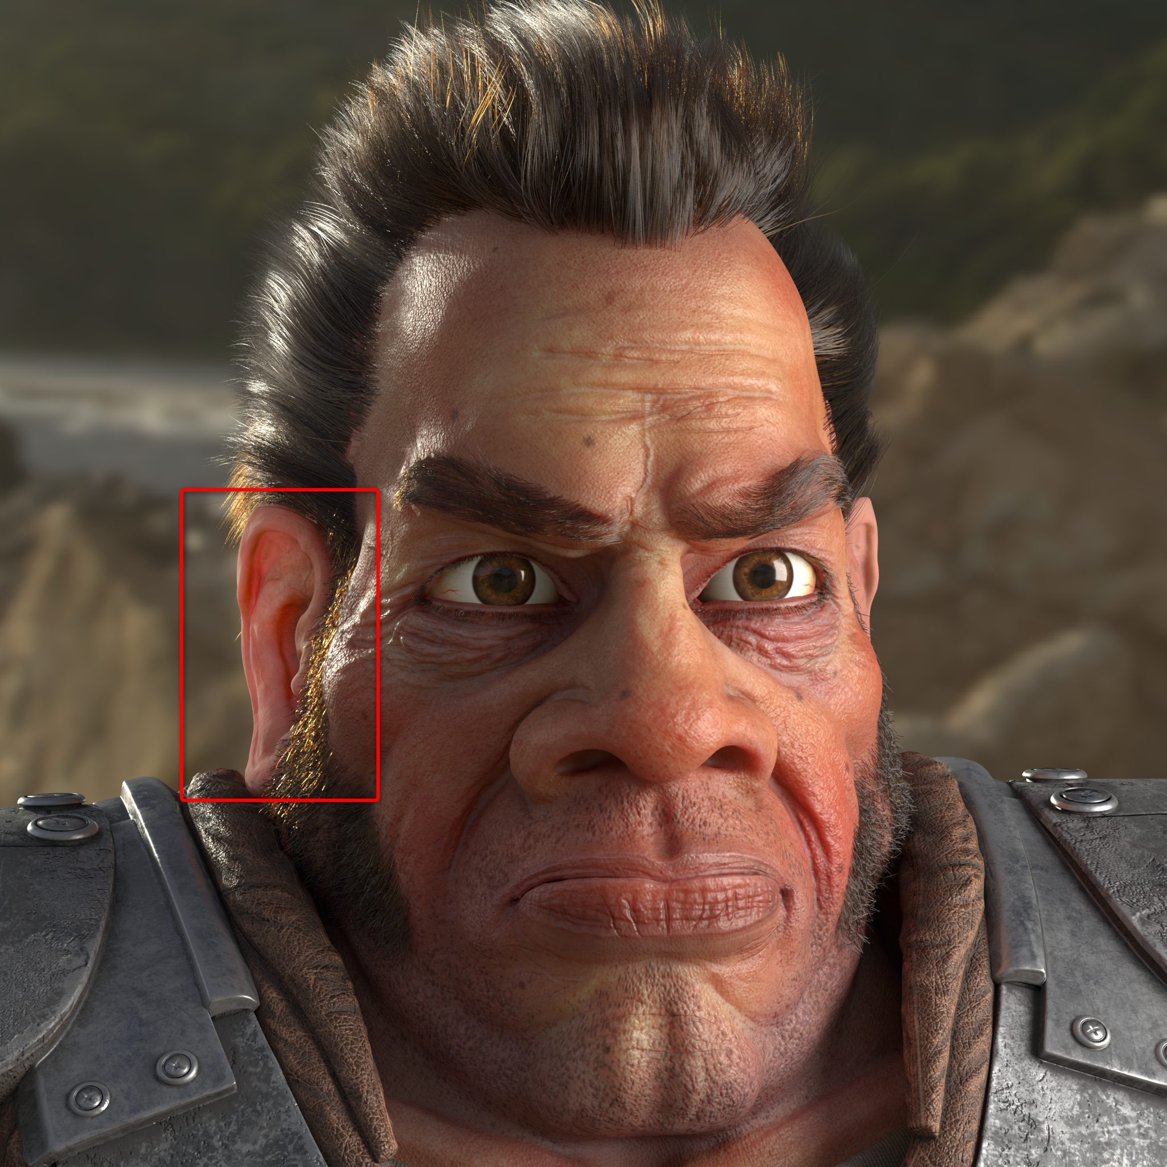
Subsurface Scattering
Used for materials that are somewhat Translucent like skin or wax.
Is caused from light that penetrates the surface and bounces around and back out of the material.
Different methods in Unreal:
  Subsurface
  Subsurface Profile
    Cheaper, mainly for skin

Slide 12
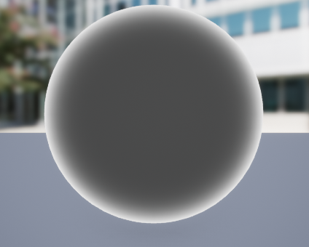
Fresnel
How light is reflected at different intensities at different angles. Is useful for materials that use refraction.

Slide 13
Resources
Unreal Documentation on PBR
Unreal Documentation on Material Properties
Unreal Documentation on Material Instances
Course on PBR materials
Substance PBR Guide (Advanced)

